Slide 1

2020 Census Inequality:
Analyzing census inequality using machine learning algorithms
George Washington Data Analytics Bootcamp
Project 4
December 2024
Gboyega Adeaga
Dawson Martin-Jones
Daniel Montano
Chris Purcell
December 2024

Slide 2
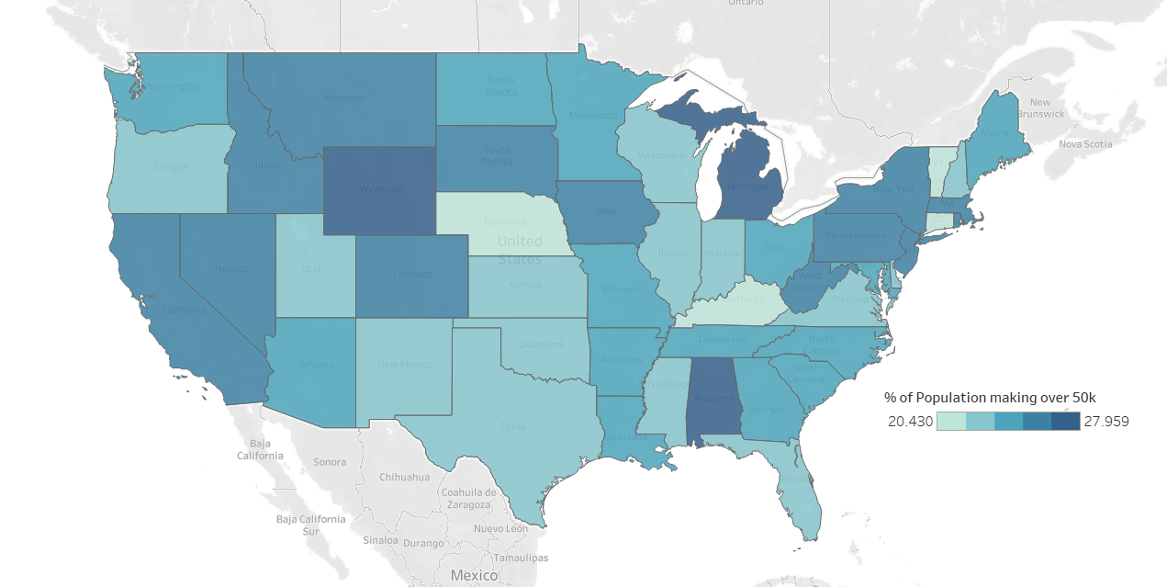
Why Care?
Income inequality is a big problem within modern day America, it’s important to understand which factors are most important in determining why income inequality is as prevalent as it is today.

Slide 3
Steps to Success
Find Census Data
Create Models
Optimize Models
Analyze Models
Visualize Findings

Slide 4

We’re Here
Why
To Create Machine Learning models to predict personal income on the Adult Census Income dataset
Business Name
Section

Slide 5
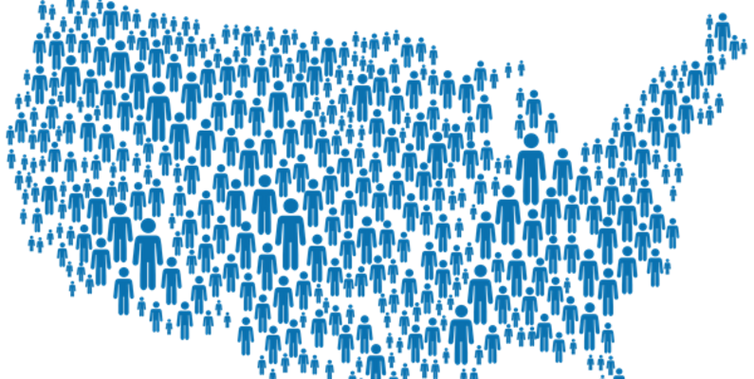
About Dataset
The Adult Census Income dataset is a rich resource for understanding the socio-economic factors that influence income levels. It contains demographic and employment information from the U.S. Census Bureau, including age, work class, education level, marital status, occupation, relationship, race, gender, hours per week worked, and native country. The dataset also includes an ‘income’ column, indicating whether the individual’s income exceeds 50K per year. This dataset is often used for classification tasks in machine learning, where the goal is to predict whether an individual’s income exceeds 50K based on the other attributes. Please note that all personal data in this dataset has been anonymized to protect privacy.
This data was extracted from the 1994 Census bureau database by Ronny Kohavi and Barry Becker (Data Mining and Visualization, Silicon Graphics). A set of reasonably clean records was extracted using the following conditions: ((AAGE>16) && (AGI>100) && (AFNLWGT>1) && (HRSWK>0)). The prediction task is to determine whether a person makes over $50K a year.
Business Name
Section

Slide 6
Which Models?
KNeighborsClassifier
Random Forest
Neural Network
Gradient Boosting
Principal Component Analysis
Decision Tree
Business Name
Section

Slide 7
Steps
Import Adult Census Income dataset
Visualizations and insights
Analyze and process Features and outcomes
Conclusions
Apply machine learning predictive modeling
Fusce dictum luctus ex lacinia posuere.
Business Name
Section

Slide 8
Overview
1 Overview 2 Ground Rules
3 Project Updates
4 Competitor Analysis
5 Future Roadmap
Business Name
Section

Slide 9
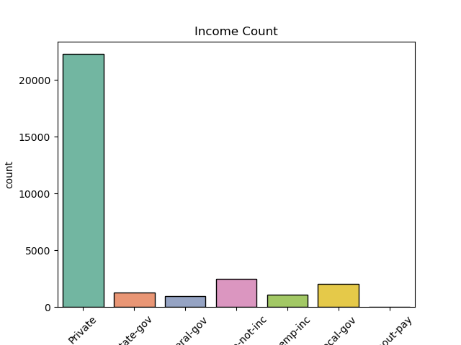
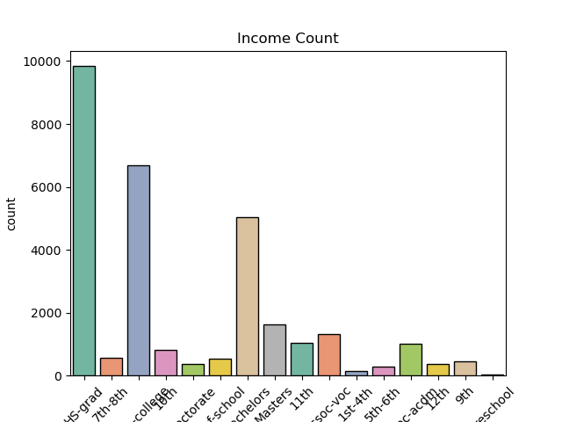
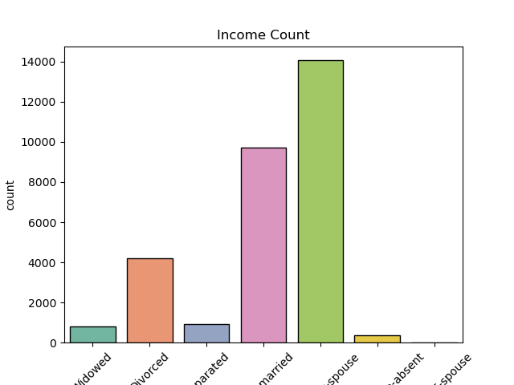
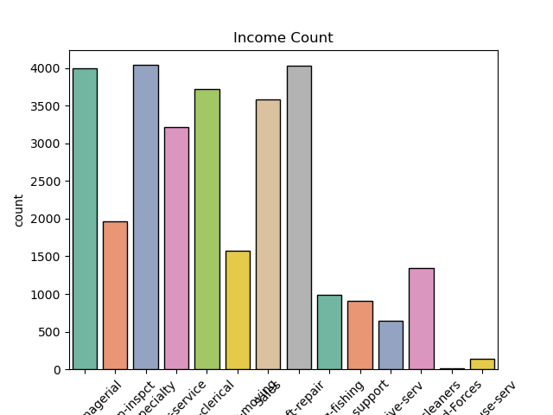
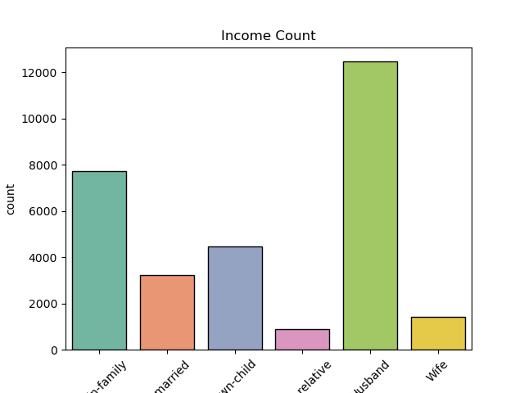
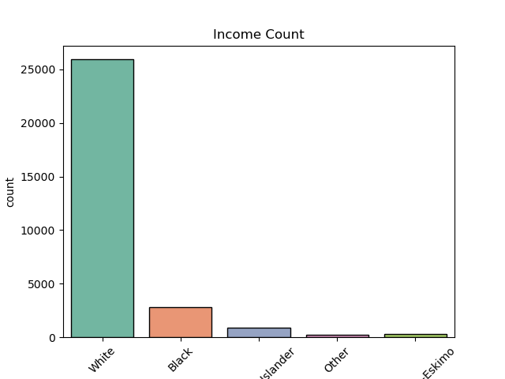
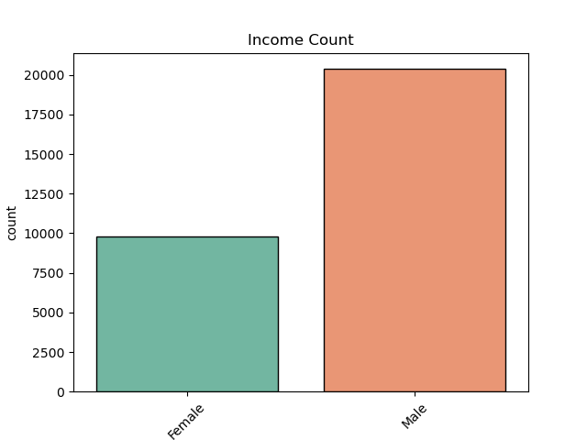
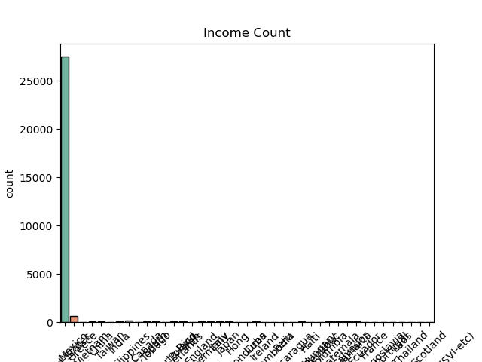
Preprocessing Analysis
workclass
education
workclass
occupation
relationship
race
sex
native_country
Business Name
Section

Slide 10
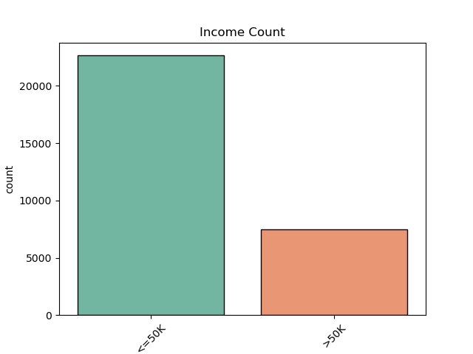
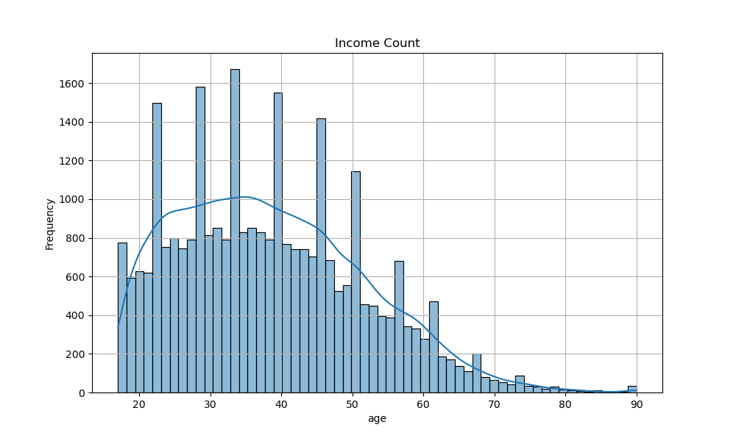
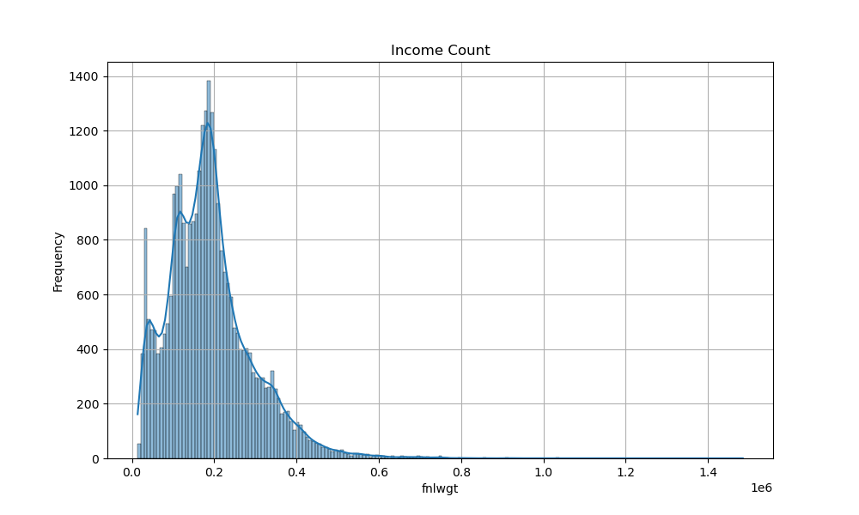
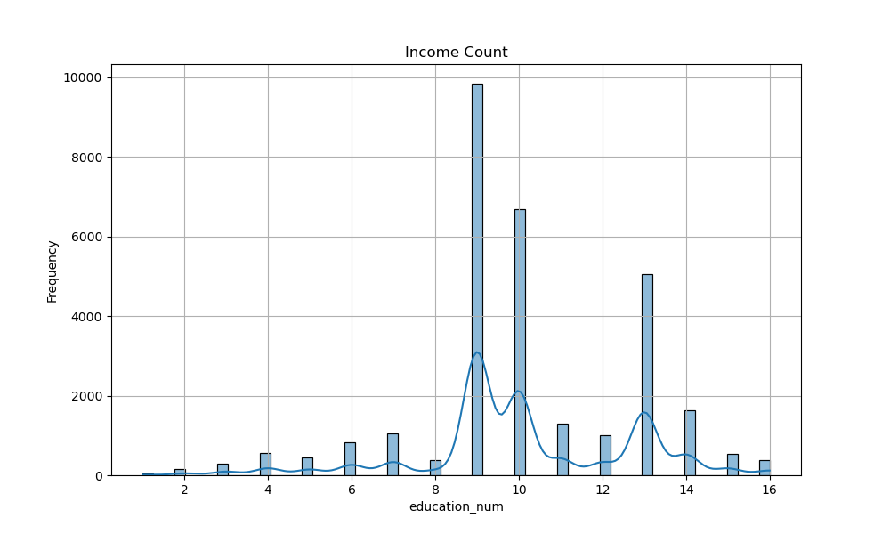
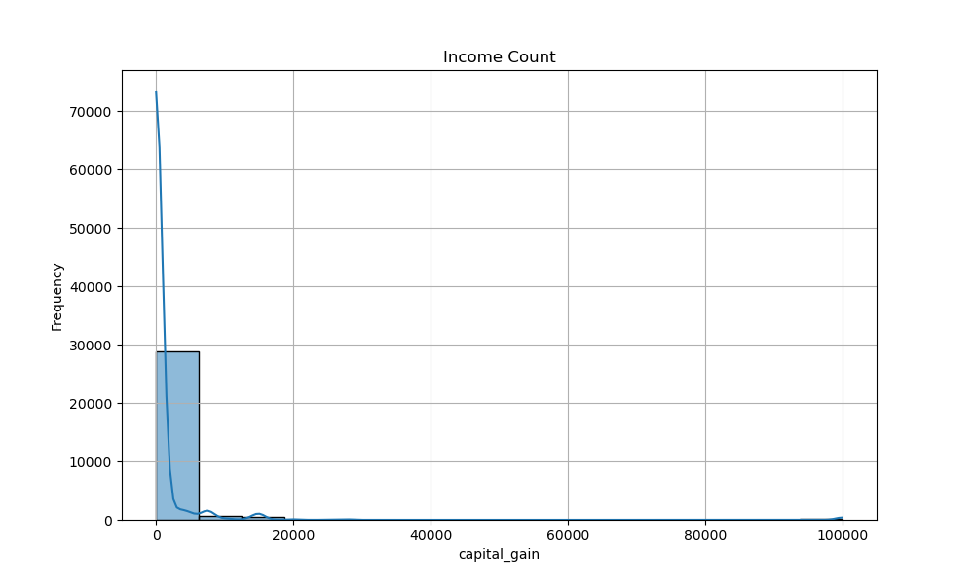
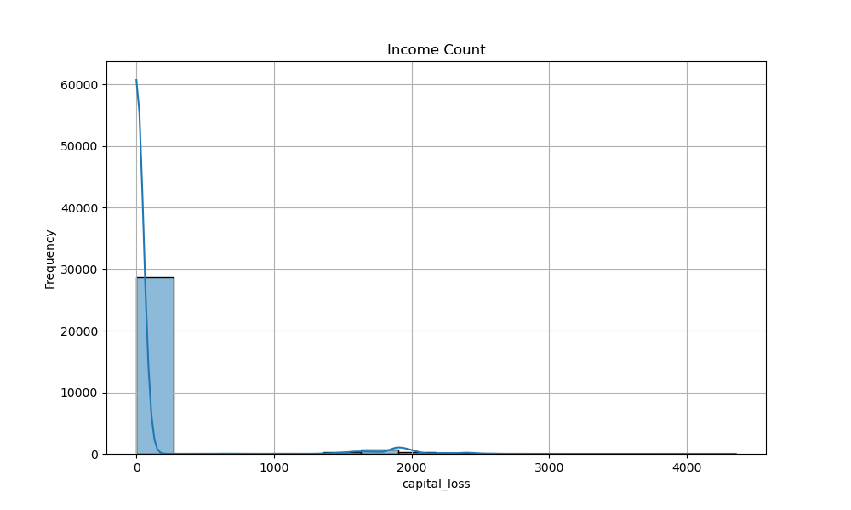
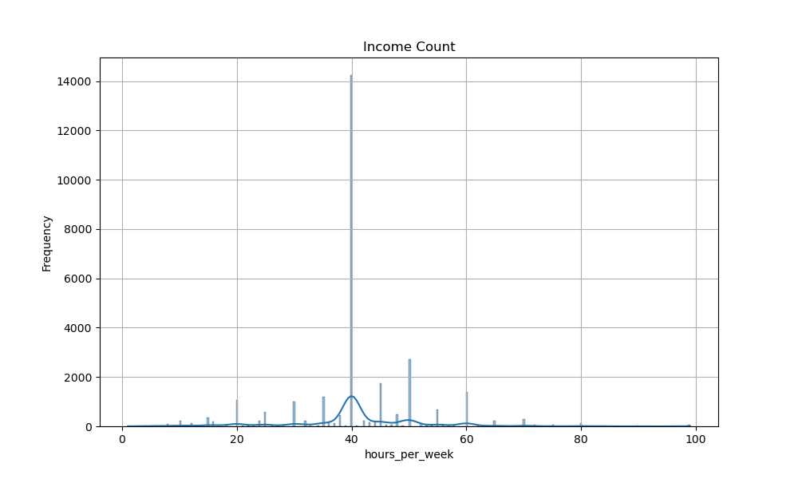
Preprocessing Analysis
income
age
fnlwgt
education_num
capital_gain
capital_loss
hours_per_week
Business Name
Section

Slide 11
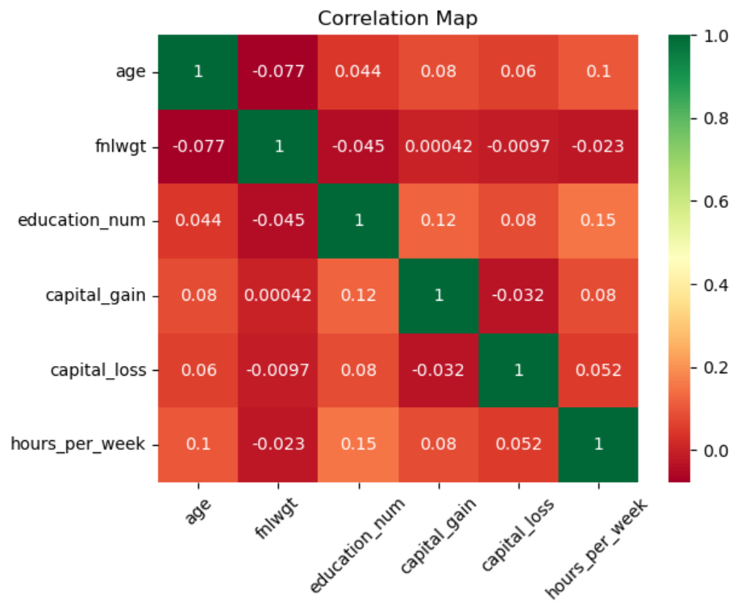
Preprocessing Analysis
Low Correlation Values:
All the correlations are relatively weak, as most values range between -0.1 and 0.2. This suggests no strong linear relationships among the variables.
Notable Positive Correlations:
education_num and hours_per_week have a correlation of 0.15, which is the highest in this matrix but still considered weak.
education_num and capital_gain are weakly positively correlated (0.12).
age and hours_per_week show a weak positive correlation (0.10).
Negligible or Negative Correlations:
Most features, like fnlwgt and others, show negligible or very weak correlations close to 0 (e.g., fnlwgt and capital_gain: 0.00042).
Weak negative correlations, such as fnlwgt and age (-0.077), suggest minimal inverse relationships.
Business Name
Section

Slide 12
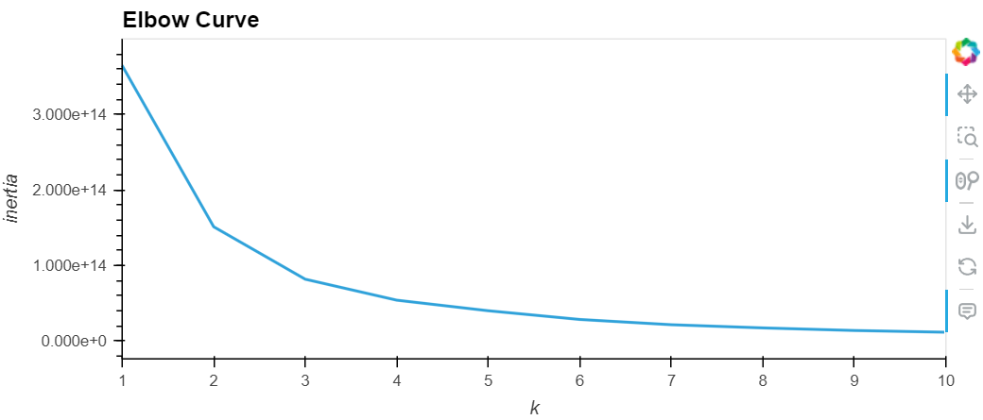
Principal Component Analysis (PCA)
Business Name
Section

Slide 13
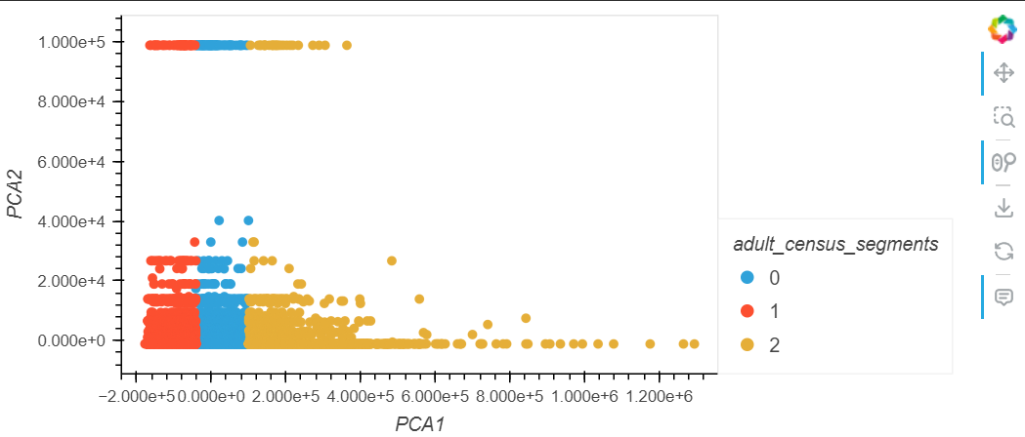
Principal Component Analysis (PCA)
Business Name
Section

Slide 14
Principal Component Analysis (PCA)
Business Name
Section

Slide 15
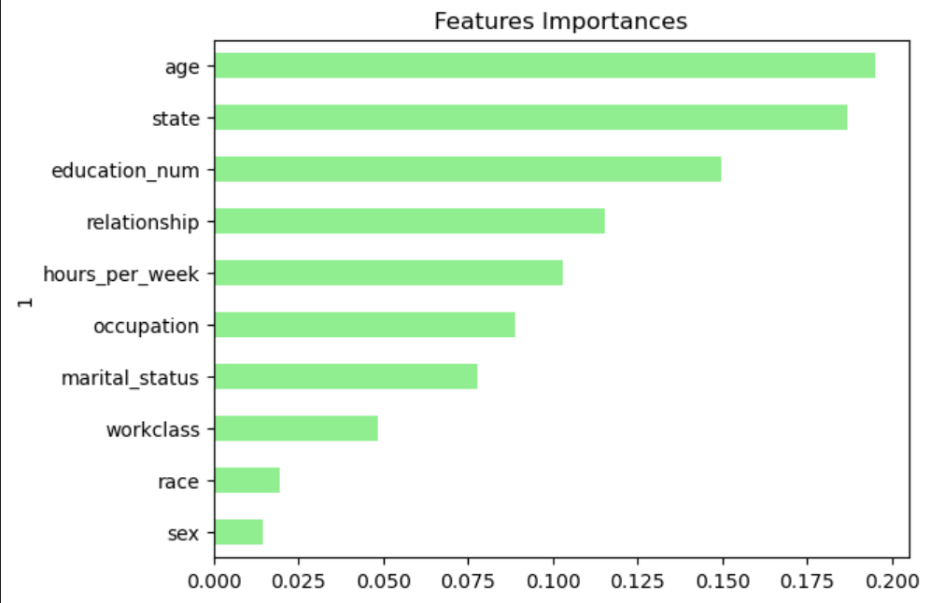
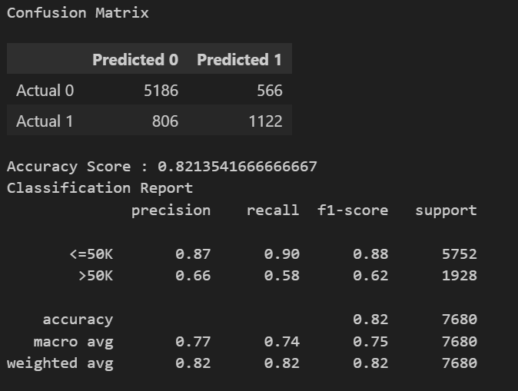
Random Forest Model Results
Business Name
Section

Slide 16
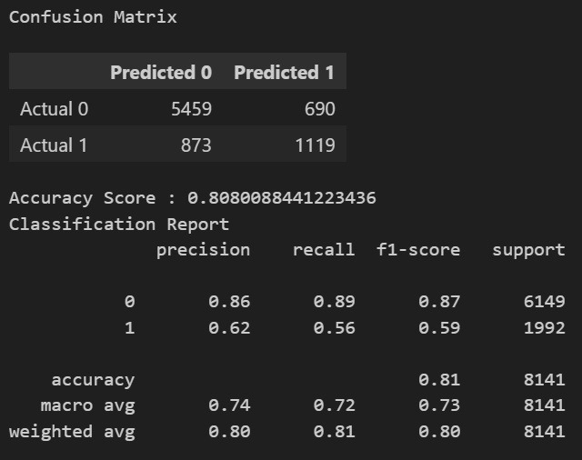
K Neighbors Model Results
Business Name
Section

Slide 17
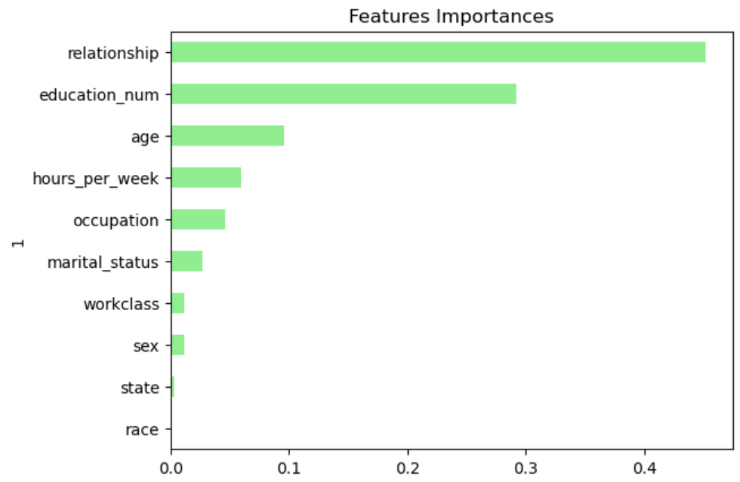
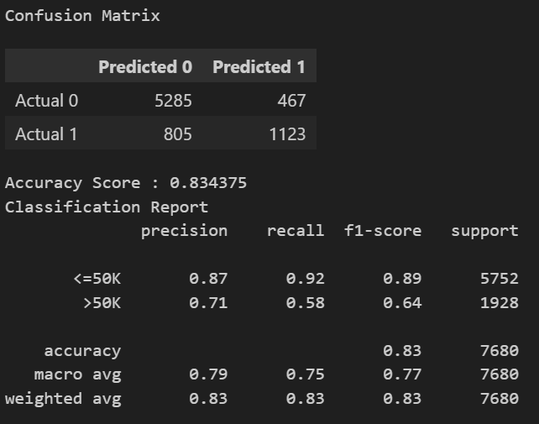
Gradient Boosting Model Results
Business Name
Section

Slide 18
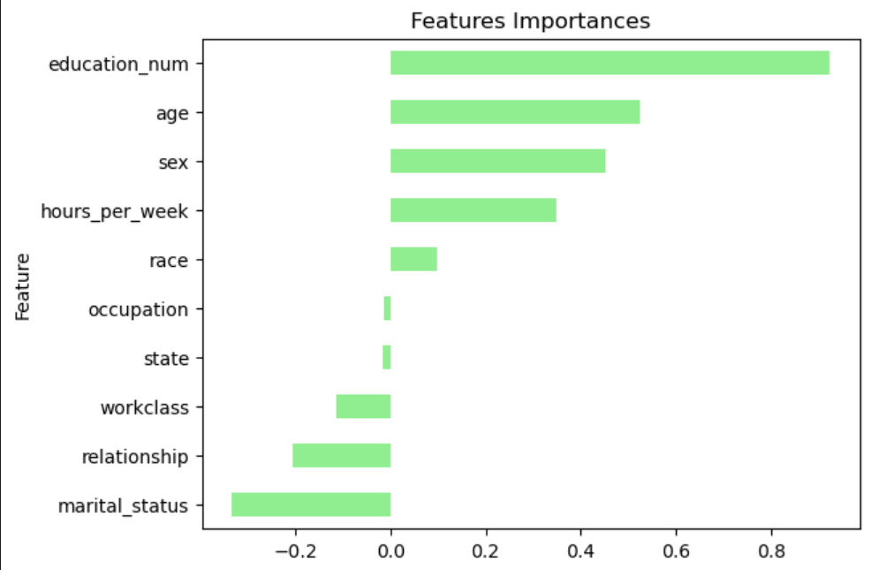
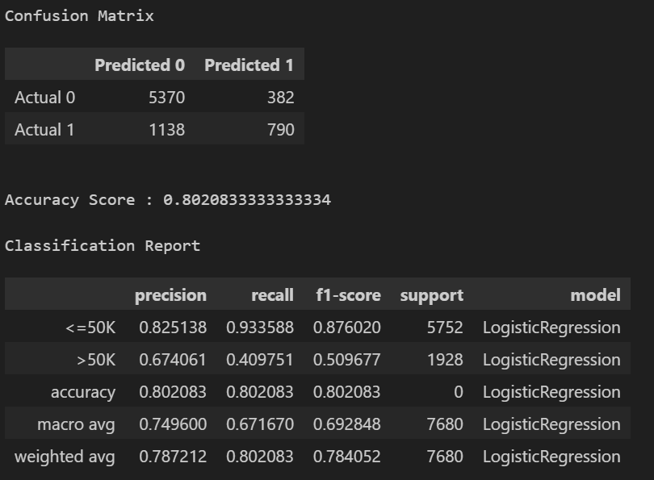
Logistic Regression Model Results
Business Name
Section

Slide 19
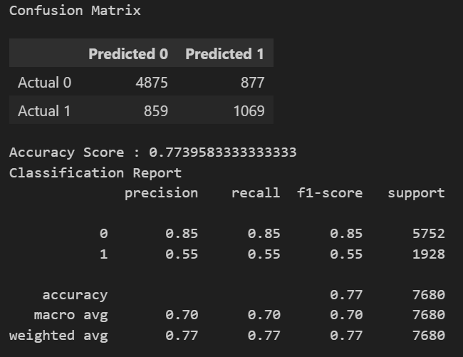
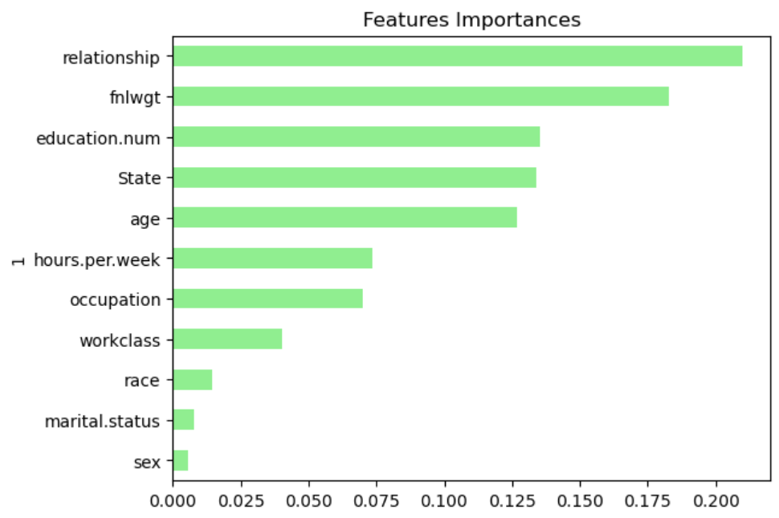
Decision Tree Model Results
Business Name
Section

Slide 20
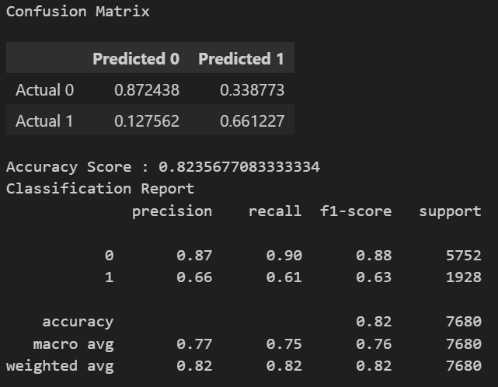
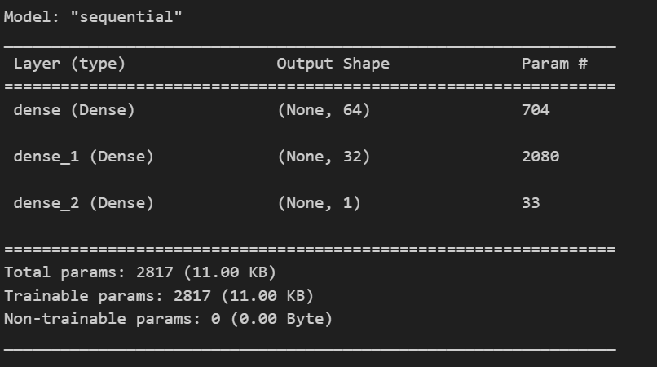
Neural Network Model Results
Business Name
Section

Slide 21
Model Accuracies
Model | Accuracy
KNeighborsClassifier | 81%
Principal Component Analysis
Neural Network | 82.3%
Random Forest | 82.1%
Gradient Boosting | 83.4%
Decision Tree | 77.3%
Business Name
Section

Slide 22

Best Model Evaluation
Gradient Boosting model had the highest accuracy.
Overall Metrics
Accuracy: 0.834 - The model correctly classified 83.4% of the samples.
Macro Average:
Precision: 0.787, Recall: 0.751, F1-score: 0.766 - Indicates moderate balance in performance across classes.
Weighted Average:
Precision: 0.827, Recall: 0.834, F1-score: 0.829 - Accounts for class imbalance, emphasizing overall performance.

Slide 23
Best Model Evaluation
Class-wise Metrics
For class <=50K:
Precision: 0.868 (Good) - The proportion of true positives among all predicted positives.
Recall: 0.919 (Very Good) - The proportion of true positives detected among actual positives.
F1-score: 0.893 - A balance between precision and recall, indicating strong performance.
Support: 5752 - The number of true instances of this class.
Gradient
Boosting

Slide 24
Best Model Evaluation
Class-wide Metrics
For class >50K:
Precision: 0.706 (Moderate) - Lower precision compared to the <=50K class.
Recall: 0.582 (Low) - Indicates the model struggles to identify instances of this class.
F1-score: 0.638 - Reflects moderate performance, highlighting imbalance in identifying >50K.
Support: 1928 - There are fewer instances of this class, potentially contributing to poorer performance.
Gradient
Boosting

Slide 25
Best Model Evaluation
Observations
The model performs better for the majority class (<=50K), which is reflected in higher precision, recall, and F1-score.
The minority class (>50K) has lower recall and F1-score, suggesting the model might benefit from:
Gradient Boosting
Class Balancing: Techniques like SMOTE* or class-weight adjustments.
Hyperparameter Tuning: Optimizing parameters for better minority class recognition.
Feature Engineering: Adding or modifying features to enhance differentiation.
* SMOTE: Synthetic Minority Oversampling Technique

Slide 26

Thank You
QUESTIONS?

